Slide 1

An Automated Annotation System for Document Text Images
GOKARAJU RANGARAJU INSTITUTE OF ENGINEERING AND TECHNOLOGY
Department of Computer Science and Engineering
MAJOR Project Final Review
~Dr. Ashlin Deepa R N, Associate Professor
  Jhansi Lakshmi - 20241A0566
    B. Srija - 20241A0564
    Maria Jabeen - 20241A0593
    K. Kushi Reddy - 20241A0583

Slide 2
Abstract:
GOKARAJU RANGARAJU INSTITUTE OF ENGINEERING AND TECHNOLOGY
Department of Computer Science and Engineering
MAJOR Project Final Review
Annotation is the practice of supplementing text with extra details or labels to offer context, enhance comprehension, or facilitate the refinement of Natural Language Processing (NLP) models. The project's core objective is to develop a robust system capable of annotating document text images with minimal human intervention. This entails outlining distinct regions within an image and then generating descriptive text that effectively encapsulates the characteristics of these outlined areas. While manual annotation is time-consuming and error-prone, automatic image annotation tools step in to address these challenges, boosting efficiency and reliability. A key focus lies in achieving word-level annotations for handwritten document images. The resultant system not only mitigates the time and resource demands of manual annotation but also enhances the reliability and accuracy of annotations. This project stands to contribute significantly to the advancement of NLP applications, particularly in scenarios involving handwritten document analysis and understanding.

Slide 3
Proposed Approach:
The proposed system initiates by constructing a Telugu-page-level dataset, which undergoes thorough pre-processing employing De-GAN and CRAFT techniques.
Subsequently, this meticulously prepared data is subjected to training across a spectrum of advanced algorithms, encompassing Convolutional Neural Networks (CNNs), Gated Convolutional Neural Networks (GCN), LSTM-based models, and encoder-decoder architectures enriched with attention mechanisms.
This comprehensive approach not only holds the promise of significantly enhancing annotation accuracy but also streamlines the entire annotation workflow, reducing the need for manual intervention.
In these fields, where precise and efficient annotations of Telugu handwritten documents are of utmost significance, our system plays a pivotal role in facilitating in-depth analysis and insightful outcomes.
GOKARAJU RANGARAJU INSTITUTE OF ENGINEERING AND TECHNOLOGY
Department of Computer Science and Engineering
MAJOR Project Final Review

Slide 4
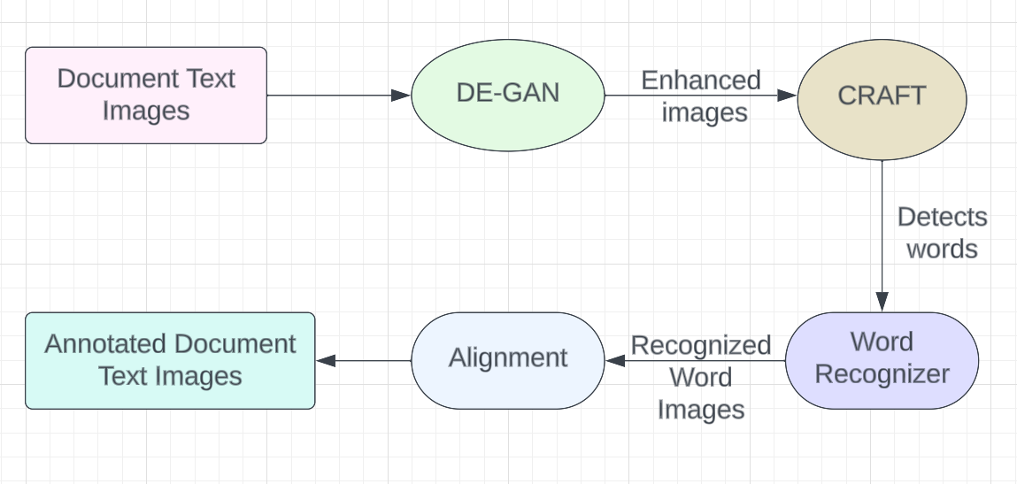
Proposed Architecture:
Fig 1: Automated Annotation System Architecture
GOKARAJU RANGARAJU INSTITUTE OF ENGINEERING AND TECHNOLOGY
Department of Computer Science and Engineering
MAJOR Project Final Review

Slide 5
GOKARAJU RANGARAJU INSTITUTE OF ENGINEERING AND TECHNOLOGY
Department of Computer Science and Engineering
MAJOR Project Final Review
Design Methodology:
Methodology for Telugu Page-Level Dataset Creation and Enhancement:
1. Dataset Creation: Collect and digitize diverse Telugu handwritten documents with annotations.
2. Pre-processing: Use De-GAN and CRAFT for noise reduction and text extraction.
3. Data Splitting: Divide the dataset into training, validation, and test sets.
4. Model Selection: Choose advanced algorithms like CNNs, GCN, LSTM-based models, and encoder-decoder with attention.
5. Training: Train models on the dataset, fine-tune with validation set, and cross-validate.

Slide 6
GOKARAJU RANGARAJU INSTITUTE OF ENGINEERING AND TECHNOLOGY
Department of Computer Science and Engineering
MAJOR Project Final Review
6. Model Evaluation: Assess accuracy, precision, recall, and F1-score; perform error analysis and manual verification.
7. Architecture Optimization: Select the best-performing model architecture and explore ensemble techniques.
8. Annotation Enhancement: Apply post-processing and evaluate the system's enhanced accuracy.
9. Testing and Reporting: Evaluate real-world performance, validate against benchmarks, and document results.

Slide 7
GOKARAJU RANGARAJU INSTITUTE OF ENGINEERING AND TECHNOLOGY
Department of Computer Science and Engineering
MAJOR Project Final Review
Module Description:
There are three main modules in our project.
De-GAN Module:
De-GAN utilizes Generative Adversarial Networks (GANs) for denoising handwritten documents.
It identifies and removes various types of noise, such as background artifacts and smudges.
It enhances the overall quality of scanned documents, making them more legible and suitable for annotation.
It employs deep learning techniques to learn and generate denoised versions of input documents.
It significantly improves dataset readiness for subsequent annotation and analysis.

Slide 8
GOKARAJU RANGARAJU INSTITUTE OF ENGINEERING AND TECHNOLOGY
Department of Computer Science and Engineering
MAJOR Project Final Review
CRAFT Module:
After binarizing the image using De-GAN, it is sent to CRAFT model.
CRAFT is a text detection model that uses a Convolutional Neural Network(CNN) model to accurately extract text regions from the document images.
It analyzes pixel-level information to determine character and word boundaries.
It utilizes computer vision algorithms to identify regions containing textual content.
The purpose of this model is to minimizes errors and enhances annotation efficiency by focusing solely on relevant text.
Annotation Module:
Annotation involves the automated labeling of pre-processed documents to make it recognizable and usable for various applications.
It employs machine learning models like CNNs, GCN, LSTM-based and encoder-decoder with attention models for automated text recognition.
It involves manual review to rectify discrepancies and ensure high accuracy.

Slide 9
The process begins with the acquisition of an image, ensuring it is taken without the influence of any filters.
The unfiltered image is fed into the pretrained De-GAN (Denoising GAN) model.
De-GAN specializes in denoising and enhances the image quality, generating a binarized version that eliminates background noises.
The binarized image produced from De-GAN serves as input for the CRAFT model, which generates a bounding box image and a mask image highlighting detected text regions.
Additionally, a text file is created, containing coordinates detailing the position of bounding boxes.
GOKARAJU RANGARAJU INSTITUTE OF ENGINEERING AND TECHNOLOGY
Department of Computer Science and Engineering
MAJOR Project Final Review
Implementation:

Slide 10
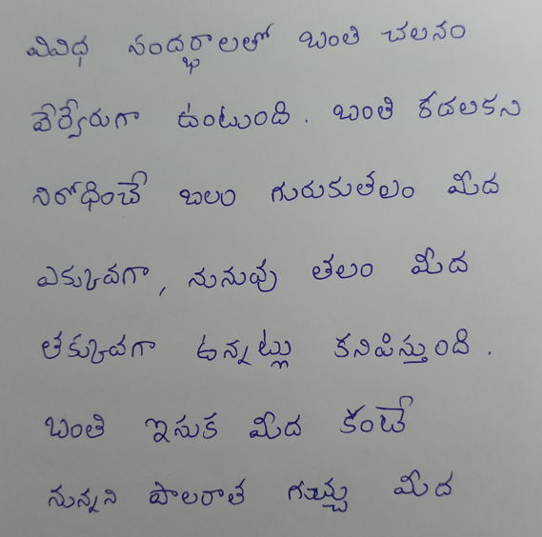
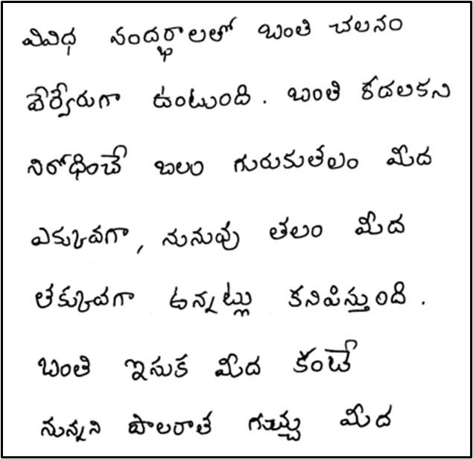
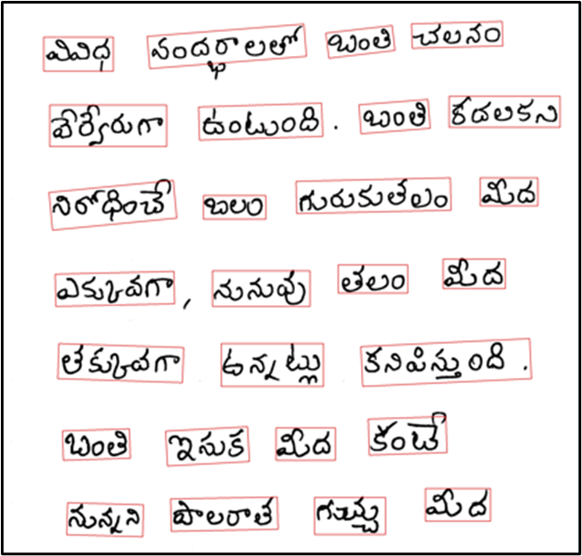
Fig 2: Original Image Fig 3: Image After De-GAN Fig 4: Image After CRAFT
GOKARAJU RANGARAJU INSTITUTE OF ENGINEERING AND TECHNOLOGY
Department of Computer Science and Engineering
MAJOR Project Final Review
Execution:

Slide 11
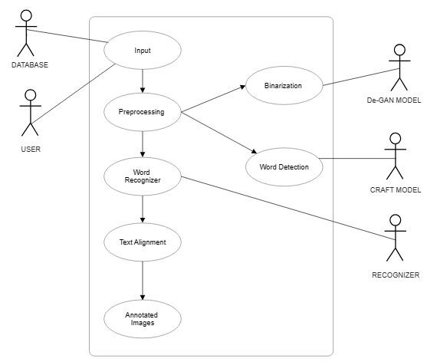
Fig 5 Automated Annotation System Use Case Diagram
GOKARAJU RANGARAJU INSTITUTE OF ENGINEERING AND TECHNOLOGY
Department of Computer Science and Engineering
MAJOR Project Final Review
Use Case Diagram:

Slide 12
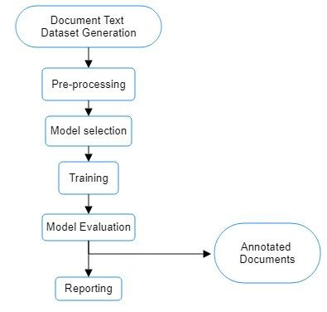
Fig 6: Automated Annotation System Data Flow Diagram
GOKARAJU RANGARAJU INSTITUTE OF ENGINEERING AND TECHNOLOGY
Department of Computer Science and Engineering
MAJOR Project Final Review
Data Flow Diagram:

Slide 13
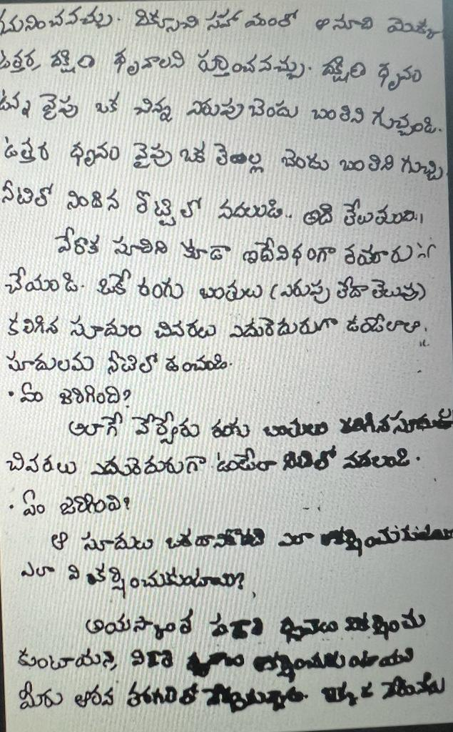
Scope Limitations:
GOKARAJU RANGARAJU INSTITUTE OF ENGINEERING AND TECHNOLOGY
Department of Computer Science and Engineering
MAJOR Project Final Review
If the document text images are subjected to filters or image enhancements, the recognition process may be impeded.
Recognition difficulties arise when the text in the document lacks sufficient spacing and is densely packed, making cleaning and generating bounding boxes challenging as shown in fig 7.
The model faces challenges when processing text containing special characters, such as question marks or numbers, as recognition may be hindered.
Fig 7: Example Image

Slide 14
GOKARAJU RANGARAJU INSTITUTE OF ENGINEERING AND TECHNOLOGY
Department of Computer Science and Engineering
MAJOR Project Final Review
References:
1. Marti, U-V., and Horst Bunke. "The IAM-database: an English sentence database for offline handwriting recognition." International Journal on Document Analysis and Recognition 5 (2002): 39-46.
2. Pippi, Vittorio, Silvia Cascianelli, and Rita Cucchiara. "Handwritten Text Generation from Visual Archetypes." Proceedings of the IEEE/CVF Conference on Computer Vision and Pattern Recognition. 2023.
3. Mustafa, W. A., et al."A comprehensive review on document image (DIBCO) database."IOP Conference Series: Materials Science and Engineering . V ol. 557. No. 1. IOP Publishing, 2019.
4. Zhou, X., “EAST: An Efficient and Accurate Scene Text Detector” , <i>arXiv e-prints</i>, 2017.doi:10.48550/arXiv.1704.03155 .

Slide 15
GOKARAJU RANGARAJU INSTITUTE OF ENGINEERING AND TECHNOLOGY
Department of Computer Science and Engineering
MAJOR Project Final Review
References:
5. Y. Baek, B. Lee, D. Han, S. Yun and H. Lee, "Character Region Awareness for Text Detection," 2019 IEEE/CVF Conference on Computer Vision and Pattern Recognition (CVPR), Long Beach, CA, USA, 2019, pp. 9357-9366, doi: 10.1109/CVPR.2019.00959.
6. Liu, Yuliang, et al. "Abcnet: Real-time scene text spotting with adaptive bezier-curve network." proceedings of the IEEE/CVF conference on computer vision and pattern recognition. 2020.
7. Z. Zhong, L. Jin and S. Huang, "DeepText: A new approach for text proposal generation and text detection in natural images," 2017 IEEE International Conference on Acoustics, Speech and Signal Processing (ICASSP), New Orleans, LA, USA, 2017, pp. 1208-1212, doi: 10.1109/ICASSP.2017.7952348.
8. Souibgui, M. A. and Kessentini, Y., “DE-GAN: A Conditional Generative Adversarial Network for Document Enhancement”, <i>arXiv e-prints</i>, 2020. doi:10.48550/arXiv.2010.08764.9

Slide 16
GOKARAJU RANGARAJU INSTITUTE OF ENGINEERING AND TECHNOLOGY
Department of Computer Science and Engineering
MAJOR Project Final Review
References:
9. Ait Bella, F.Z., El Rhabi, M., Hakim, A. et al. An innovative document image binarization approach driven by the non-local p-Laplacian. EURASIP J. Adv. Signal Process. 2022, 50 (2022).
10. Mustafa, Wan & Kader, Mohamed. (2018). Binarization of Document Images: A Comprehensive Review. Journal of Physics: Conference Series. 1019. 012023. 10.1088/1742-6596/1019/1/012023.
11. Trippe, Theophil, et al. "Let's enhance: A deep learning approach to extreme deblurring of text images." arXiv preprint arXiv:2211.10103 (2022).
12. Jain, Mohit & Mathew, Minesh & Jawahar, C.V.. (2017). Unconstrained OCR for Urdu Using Deep CNN-RNN Hybrid Networks. 747-752. 10.1109/ACPR.2017.5.

Slide 17
GOKARAJU RANGARAJU INSTITUTE OF ENGINEERING AND TECHNOLOGY
Department of Computer Science and Engineering
MAJOR Project Final Review
References:
13. Coquenet, Denis & Chatelain, Clement & Paquet, Thierry. (2020). End-to-end Handwritten Paragraph Text Recognition Using a Vertical Attention Network.
14. Ganji, T., Sekhar Velpuru, M., and Dugyala, R., “Multi Variant Handwritten Telugu Character Recognition Using Transfer Learning”, in <i>Materials Science and Engineering Conference Series</i>, 2021, vol. 1042, no. 1, p. 012026. doi:10.1088/1757-899X/1042/1/012026.
15. Mathew, Minesh, and C. V. Jawahar. "An empirical study of CTC based models for OCR of Indian languages." arXiv preprint arXiv:2205.06740 (2022).
16. Base paper : Mondal, Ajoy & Tulsyan, Krishna & Jawahar, C.. (2022). Automatic Annotation of Handwritten Documents in Word Level. 10.1145/3571600.3571645.

Slide 18
GOKARAJU RANGARAJU INSTITUTE OF ENGINEERING AND TECHNOLOGY
Department of Computer Science and Engineering
MAJOR Project Final Review
Review Paper
1. Dataset Creation[1,2,3]:
Handwritten and Printed Datasets: Annotation is conducted on two distinct types of datasets—handwritten and printed documents.
Significance: Recognizing the diversity in document types allows the system to cater to a wide range of applications, ensuring adaptability to various input sources.
2. Pre-processing[8,9,10,11]:
Text Recognition Enhancement: Pre-processing involves a set of techniques applied to raw input data, aiming to enhance overall quality and readability before recognition.
Objectives: The primary goals include improving text clarity, noise removal, distortion correction, and preparing data for accurate text recognition by OCR engines.

Slide 19
GOKARAJU RANGARAJU INSTITUTE OF ENGINEERING AND TECHNOLOGY
Department of Computer Science and Engineering
MAJOR Project Final Review
Review paper:
3. Word Detection[4,5,6,7]:
Localization of Text: Word Detection is a pivotal step in text recognition, involving the precise identification and location of individual words or text regions within a document image.
Criticality: This initial phase sets the foundation for subsequent recognition processes, impacting the system's ability to accurately interpret and annotate text.
4. Word Recognition and Annotation[12,13,14,15,16]:
Challenging Task: Text recognition in document images is a challenging yet crucial task with diverse applications, from digitizing historical manuscripts to aiding in automatic form processing.
Algorithm Development: This field requires the development of algorithms and methodologies for recognizing and annotating words, contributing to the system's overall efficiency in handling document text images.

Slide 20
GOKARAJU RANGARAJU INSTITUTE OF ENGINEERING AND TECHNOLOGY
Department of Computer Science and Engineering
MAJOR Project Final Review
Conclusion:
In conclusion, an Automated Annotation System designed for document text images brings transformative benefits to various industries. By leveraging advanced image processing techniques, such as Optical Character Recognition (OCR) and deep learning algorithms, this system significantly enhances document analysis, data extraction, and information retrieval processes. It optimizes efficiency, accuracy, and productivity by automating the time-consuming task of manual annotation. This system finds applications in areas ranging from digitizing historical archives and cataloging large document databases to aiding in content indexing and semantic understanding. As technology continues to advance, the development and adoption of Automated Annotation Systems for Document Text Images hold the promise of revolutionizing the way we interact with and extract knowledge from textual documents.

Slide 21
THANK YOU & QUERY
GOKARAJU RANGARAJU INSTITUTE OF ENGINEERING AND TECHNOLOGY
Department of Computer Science and Engineering
MAJOR Project Final Review

